Slide 1
Book3
File created on: 01-07-2022 15:26:57

Slide 2
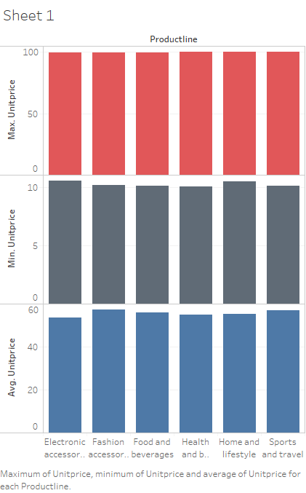

Slide 3
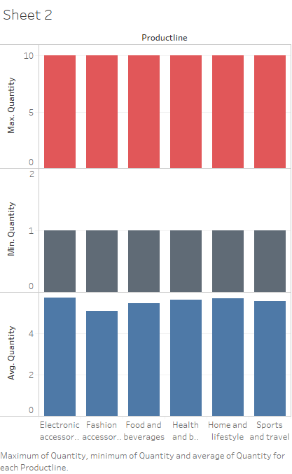

Slide 4


Slide 5
